Slide 1
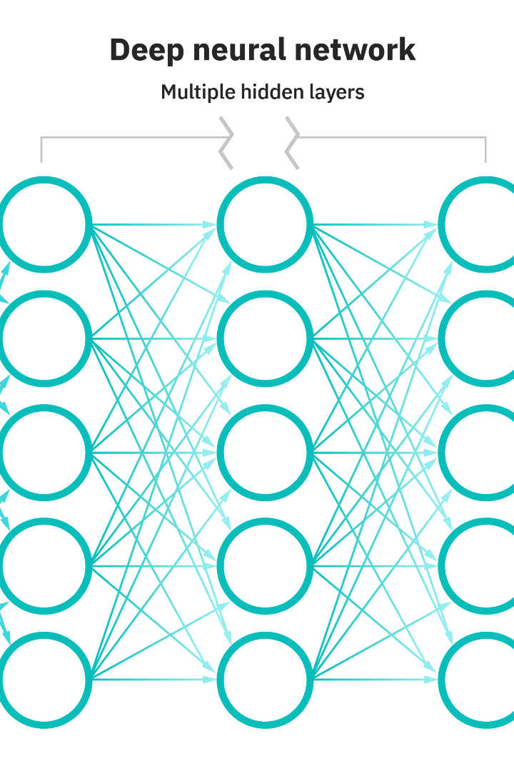
NLP Networks Bi Lstm
Neural networks lie at the heart of deep learning, enabling computers to learn from experience and make increasingly sophisticated decisions. This presentation will explore the architecture and application of Bidirectional LSTMs in NLP.

Slide 2


Understanding Bidirectional LSTMs
Unidirectional LSTMs
Bidirectional LSTMs
Process sequences only in a forward direction, encoding past information but not future.
Process sequences in both forward and backward directions, encoding past and future information.

Slide 3
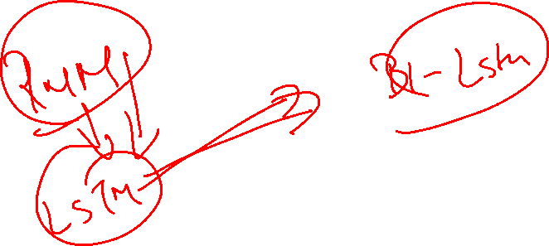
Bidirectional Sequential Data Analysis
Challenges
Solutions
Sequential data often has complex dependencies and long-range connections that are difficult to capture using traditional machine learning approaches.
Bidirectional LSTMs have taken NLP research by storm, enabling researchers to model complex sequences and make predictions with impressive accuracy.

Slide 4
Architecture of Bidirectional LSTM
LSTM Layer
Composed of memory cells, forget gates, and input gates, BiLSTM layers are able to "remember" important features from past and future timesteps.
1
2
3
Input Layer
Output Layer
Accepts input sequences and processes them in a forward and backward direction.
Combines the output from the forward and backward LSTMs and outputs a prediction.

Slide 5


Combining Forward and Backward Context
Forward
Backward
Encodes past information to help predict the next word.
Encodes future information to help predict the previous word.

Slide 6
Training Bidirectional LSTMs
1
Backpropagation
Optimizes the weights in the network by comparing predictions to actual outcomes.
Vanishing Gradient
2
Occurs when the gradients in the network become too small to make significant changes to the weights.
3
L1/L2 Regularization
Prevents overfitting and improves generalization by adding a penalty to the weight update equation.

Slide 7
Applications of BiLSTM in NLP
Text Classification
Named Entity Recognition
Classify text based on its content, such as sentiment analysis or spam detection.
Identify important entities in text like people, organizations, and locations.
Machine Translation
Summarization
Translate text from one language to another based on contextual cues.
Create a shorter, more concise version of a text while preserving its meaning.

Slide 8


Text Classification with BiLSTM
Positive Reviews
Negative Reviews
"This movie was fantastic! I laughed and cried and couldn't look away!"
"This movie was terrible! The acting was wooden and the story was predictable."

Slide 9
Named Entity Recognition using BiLSTM
Person
"John Smith is running for president."
1
2
3
Location
Organization
"I went to New York last summer and saw the Statue of Liberty."
"I work for Acme Corporation."

Slide 10

Machine Translation with BiLSTM
1
Sequence to Sequence
Encode input sequence and decode output sequence, using the context from both forward and backward LSTMs.
2
Attention Mechanism
Allows the network to focus on different parts of the input sequence at different timesteps.

Slide 11
Limitations and Considerations
Data Requirements
Resource Intensive
Interpretability
Require large amounts of labeled data to achieve high accuracy.
Require powerful GPUs or other hardware to train efficiently.
Can be difficult to interpret how the network is making its predictions.

Slide 12
Improving BiLSTM Performance
Transfer Learning
Use a pre-trained model instead of training from scratch to improve accuracy.
1
2
3
Preprocessing
Ensemble Methods
Normalize text, remove stop words, and perform other text cleaning operations.
Combine the predictions of multiple models to improve overall accuracy.

Slide 13

Future Prospects of BiLSTM
1
Other Languages
Apply to other languages besides English.
2
Other Applications
Apply to other domains with sequential data, like music and finance.

Slide 14

Conclusion
The Future is Bright
As NLP research continues to evolve, BiLSTM networks will no doubt play an increasingly important role in enabling machines to understand human language more accurately and effectively.

